Slide 1
Quartz mansion
Producer: Jermo
Lead Art & SCRUM: Stanley
UX: Jorrit & Stefan
Lead Program: Daniel

Slide 2
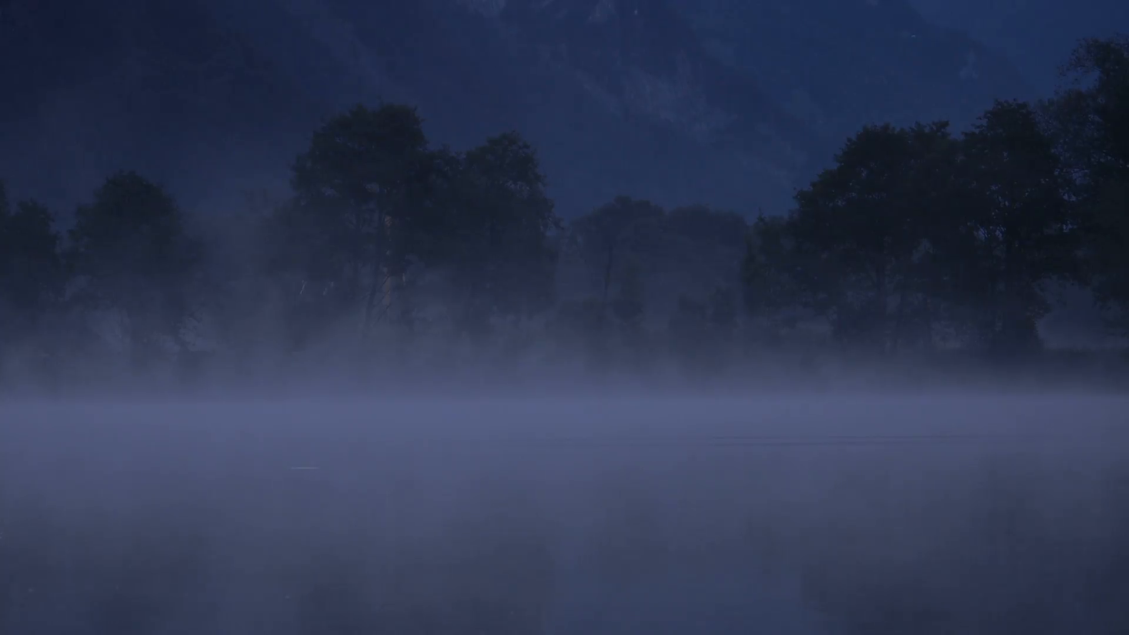
Inhoud
Inspiration
Setting
Style
Mechanics
U.x.
Questions

Slide 3
Inspiration
Amnesia
Friday the 13th

Slide 4
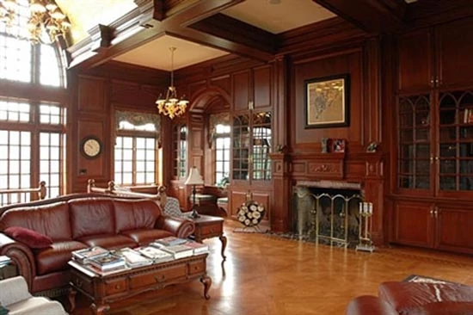
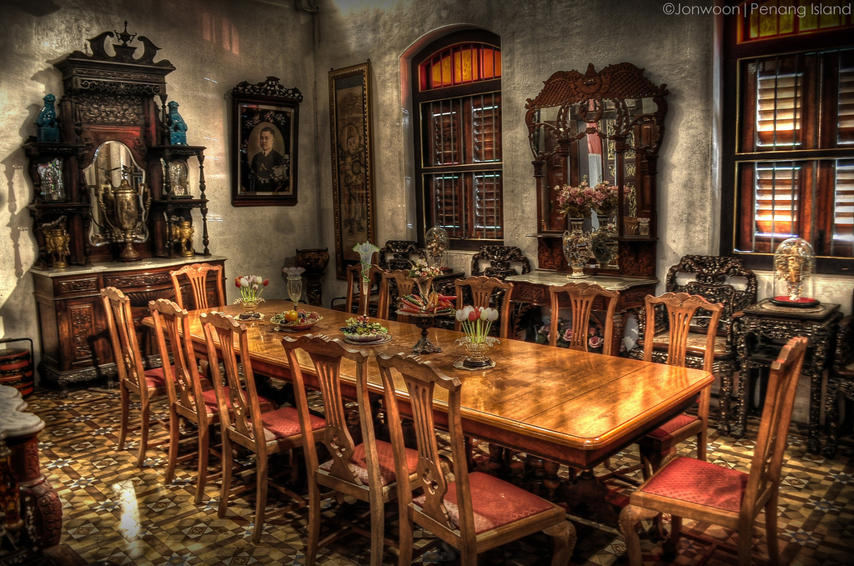
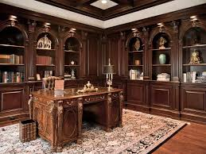
Setting
Modern
Time-blend 20th Century

Slide 5
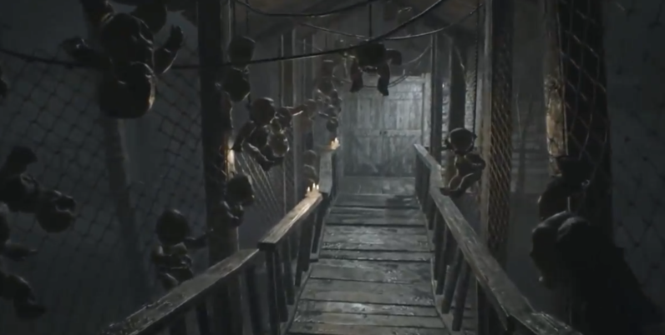
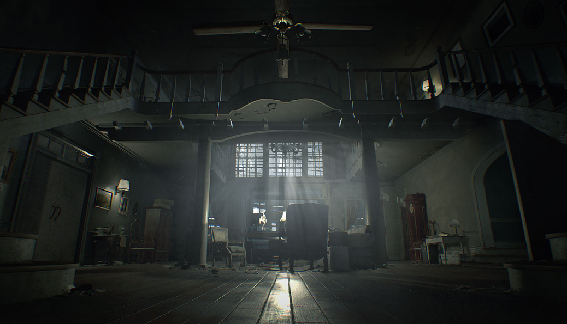
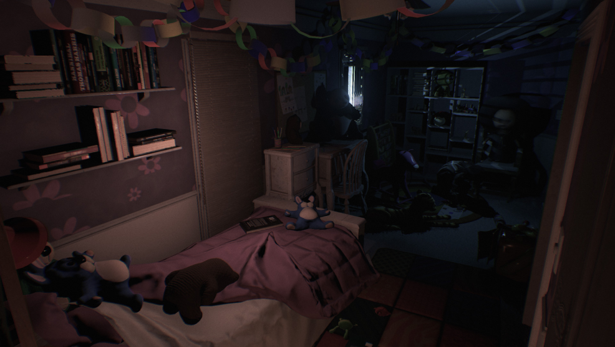
Style
Realistic
Eerie
Tense

Slide 6
Mechanics
Move & hide
Search
Corner of the eye

Slide 7
U.X.
Never safe
Lighting
Sound
Effects
Minimal UI

Slide 8
Questions?

